Slide 1
Arima forecasting for traffic prediction
Presented by Group Number-10:
Hemant Kumar (21CE10027)
Ijom Romin (21CE10028)

Slide 2
What is arima forecasting?
ARIMA stands for Autoregressive Integrated Moving Average, which is a widely used statistical method for time series analysis and forecasting. ARIMA models are used to model and forecast data with a linear dependence among the observations and can capture the effects of seasonality and trends.
The ARIMA model has three main components: autoregression (AR), differencing (I), and moving average (MA). The autoregression component models the linear dependence between an observation and a lagged value of the same time series, while the moving average component models the linear dependence between an observation and the error term of a moving average model applied to lagged values of the time series. The differencing component is used to remove the trend or seasonality in the data.
ARIMA is associated with three salient parameters p,d and q. And is often written as ARIMA(p,d,q).

Slide 3
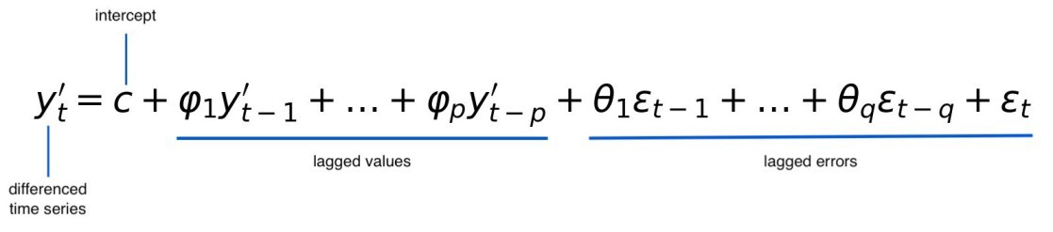
Arima Modelling
The below equation shows an ARIMA model of parameters p and q.
The value at time t depends on the previous values, the errors and an additional error term.
We can also observe that it is a linear model.

Slide 4
Steps to implement arima
Data collection: First we collect historical data which can include the number of occurrences of a particular event in a given amount of time (hourly, daily and weekly etc.).
Data Processing: Once, we have the data, we do certain adjustments such as removing outliers, filling in missing values and converting it into a time series format. (Divided in certain defined intervals)
Model selection: We find the appropriate ARIMA model based on the data. We analyze the ACF (Auto correlation function) and PACF (Partial auto correlation function) plots and determine the values of p and q. Also we see the trend and apply suitable order of differencing.
Model fitting: Since we have the ARIMA(p,d,q) we fit a suitable model based on the parameters. We also estimate these parameters using techniques such as maximum likelihood estimation.
Model evaluation: Now we evaluate the performances of the model either by comparing with actual values or by calculating various performance metrics such as mean absolute error (MAE) and mean squared error (MSE).

Slide 5
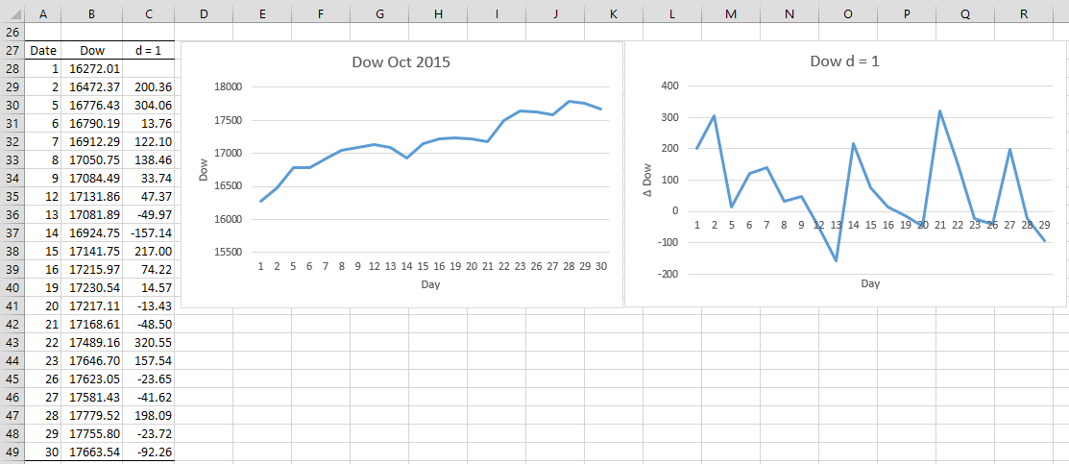
Before and after differencing once. (d=1)
We can observe that the data becomes stationary and the linear trend is removed.

Slide 6
Suitable data
The data should have clear trend and seasonality. White noise is avoided as it cannot be modelled.
Being stationary (Constant mean and variance) is a prerequisite.
Sample size should be large enough to allow for accurate modelling and forecasting.

Slide 7
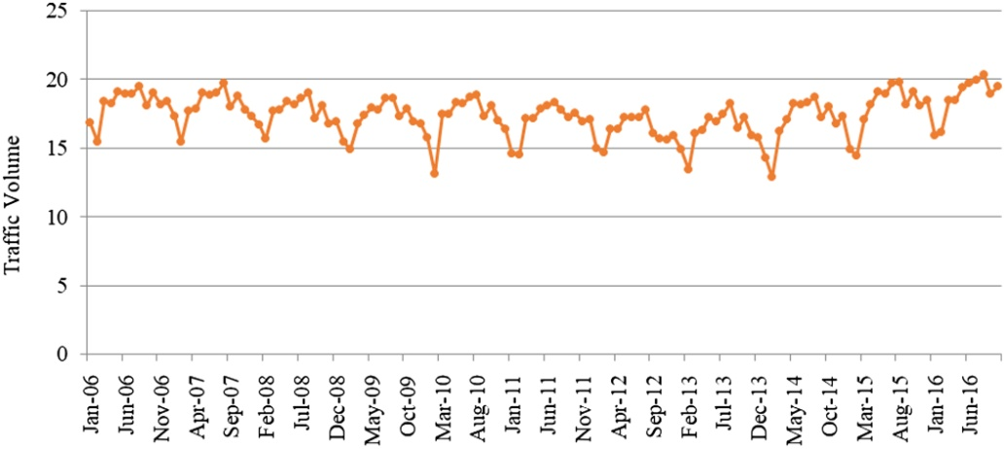
Relevance?
ARIMA models can be used for traffic volume forecasting to predict future traffic volumes, which is important for traffic management, road safety, and transportation planning. Below is an example of traffic volume data.

Slide 8
Contd…
It can also be used to predict the volume of passengers on various transportation services. The information can be used to prepare in advance.
It can also be used to predict the demand and volume of different types of vehicles which are being bought and used by the public to plan for future developments.

Slide 9
Problem statement
To forecast the future volume of traffic on a specific road network using past data. We will predict the ADT (Average Daily Traffic) values of this road network. Then use this information to optimize, manage and enhance the mobility of the flow entities and their safety.

Slide 10
Implementing arima on traffic data
As already discussed we will follow the various steps mentioned above.
Collect a significant amount of data and process it, then find a suitable model, evaluate the said model and finally forecast.

Slide 11
Advantages of ARIMA forecasting
Handles seasonality: ARIMA can handle seasonal and non-seasonal time series data and make predictions accordingly.
Easy to interpret: ARIMA models are relatively easy to interpret and explain.
No assumptions about data distribution: ARIMA does not make any assumptions about the distribution of data.
Flexible: ARIMA allows for the incorporation of external variables or covariates that can improve the accuracy of the model.

Slide 12
Disadvantages of ARIMA forecasting:
Requires stationary data: ARIMA requires time series data to be stationary, which can be difficult to achieve in practice.
Not suitable for long-term forecasting: ARIMA is best suited for short-term forecasting, typically up to one or two periods ahead.
Sensitive to outliers: ARIMA models can be sensitive to outliers, which can affect the accuracy of the model and the resulting forecasts.
Parameter selection: ARIMA models require the selection of appropriate model parameters, which can be time-consuming.

Slide 13
Thank you.

Slide 14
Reference
https://www.google.com/url?sa=i&url=https%3A%2F%2Fwww.enjoyalgorithms.com%2Fblog%2Ftime-series-forecasting-using-machine-learning%2F&psig=AOvVaw3y5oqAOXi3ndTj6zajVn74&ust=1678205566445000&source=images&cd=vfe&ved=0CBEQjhxqFwoTCIjV4IbZx_0CFQAAAAAdAAAAABAE
https://www.google.com/url?sa=i&url=https%3A%2F%2Freal-statistics.com%2Ftime-series-analysis%2Farima-processes%2Farima-differencing%2F&psig=AOvVaw2xLYLfALEUBvMzo-8dlwg6&ust=1678208162205000&source=images&cd=vfe&ved=0CBEQjhxqFwoTCNji29zix_0CFQAAAAAdAAAAABAJ
https://www.google.com/url?sa=i&url=https%3A%2F%2Fascelibrary.org%2Fdoi%2F10.1061%2FJTEPBS.0000281&psig=AOvVaw1zdPqyXJGkyfRgSmzKs0O5&ust=1678206366479000&source=images&cd=vfe&ved=0CBEQjhxqFwoTCMignoTcx_0CFQAAAAAdAAAAABAJ

